Slide 1
Technology and Resources for the classroom

Slide 2
Technology in the classroom
“Applied effectively, technology implementation not only increases student learning, understanding, and achievement but also augments motivation to learn, encourages collaborative learning, and supports the development of critical thinking and problem-solving skills (Schacter & Fagnano, 1999).
There are many resources that exist that you could apply in the classroom.
Recommendation: Try one or two resources and test how they could be applied in your class.

Slide 3
FREE Resources available online
We will look at the following resources:
Classroom management
Behavior management
Flipped Classroom
Blogging
Instructional
Assessment
Primary Resources
Financial Resources

Slide 4
Noise Down
This app is free for download and allows for an acceptable decibel level to be set – with an audible alarm.
Great for facilitating quieter classroom discussion and independent work time.
Alarm goes off once decibel level is below the set level.
Available on the APP Store for Apple or Android devices.

Slide 5
Remote Mouse
Turn your Smartphone or tablet into a mouse for your computer or presentation projector.
This free app (and computer program) will link the screen on your device to the screen on your computer.
Works very well for PowerPoint presentations or Prezi 's.
Available on the APP Store for Apple or Andriod devices.

Slide 6
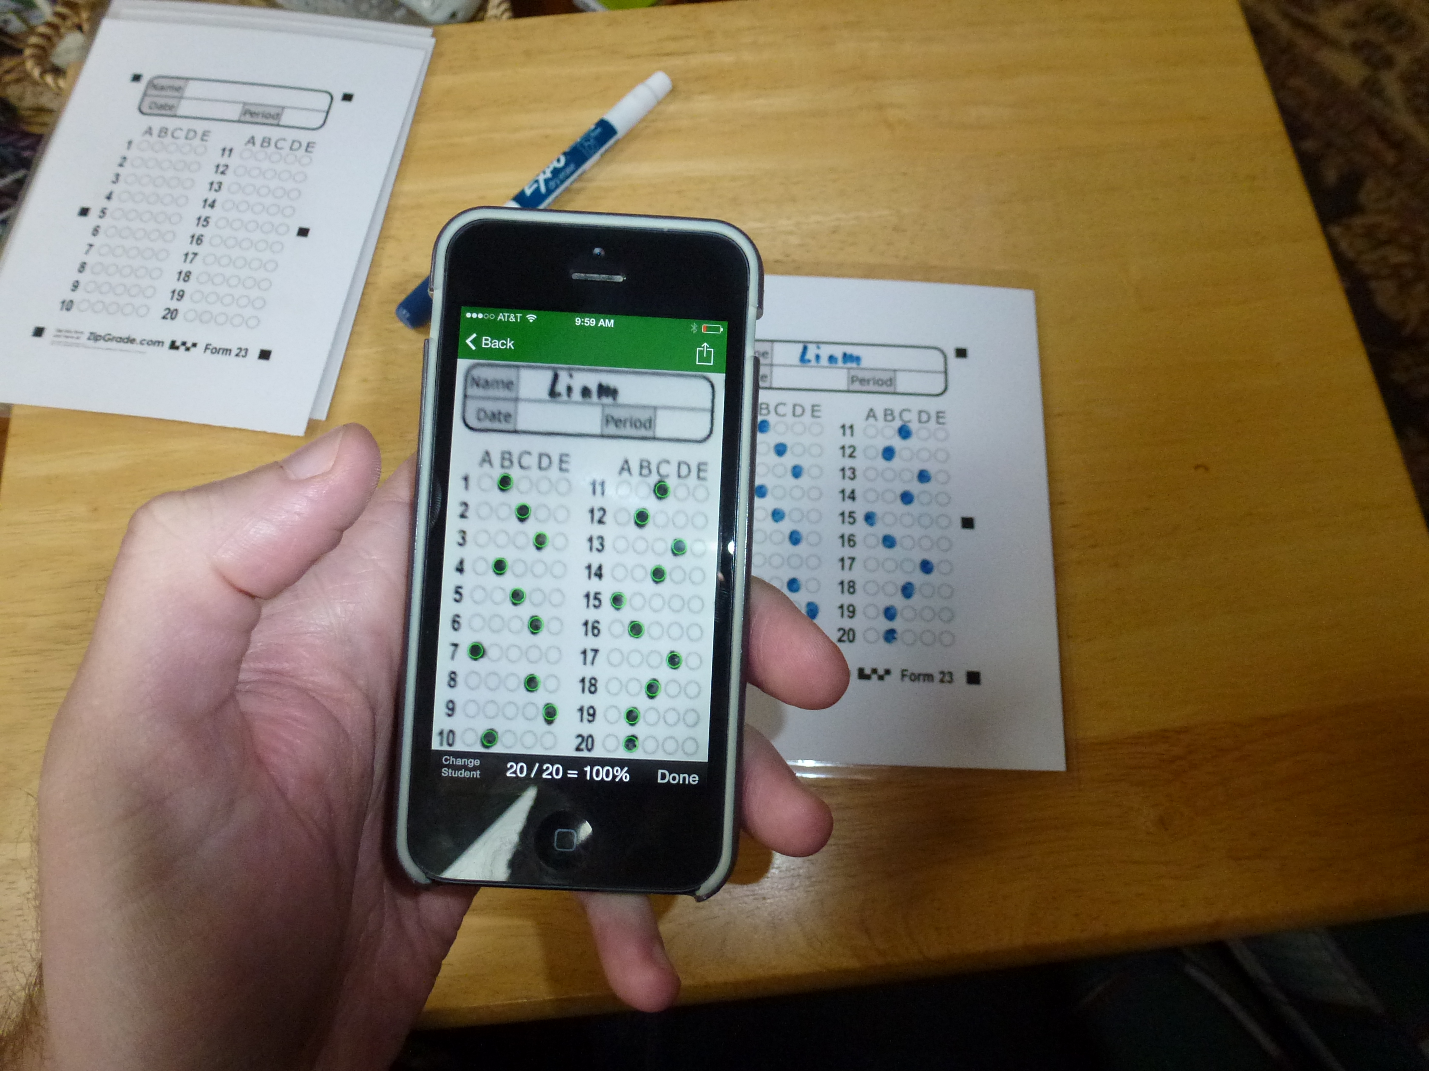
Zip Grade
This free app allows you to use a photocopied scantron type bubble test.
Your Smartphone (through the app) or computer act as the scanner and grade the exam instantly.
The app keeps a log of the students scores for easy gradebook transfer.
Check it out at Zip Grade

Slide 7
Poll Everywhere
Poll Everywhere is a great way to take feedback or instantly formatively assess the class.
Students can use text messages to respond to multiple choice questions.
The projector or your own PowerPoint presentation can become a poll everywhere poll
This is a great way to do EXIT TICKETS!

Slide 8
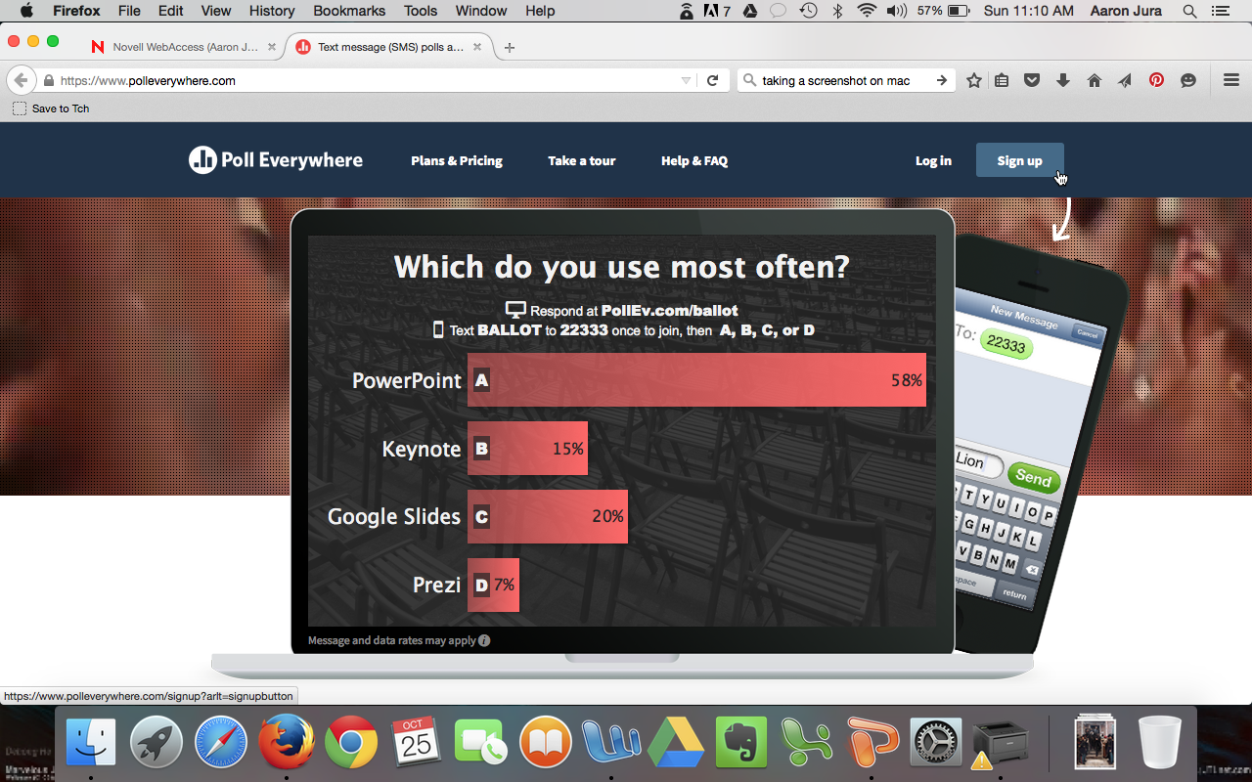

Slide 9
Class Dojo
Video: https://www.youtube.com/watch?v=ZZ27nMOVI_g
Free download/account
Used to encourage good behavior and discourage bad behavior.
Record classroom participation in an active way using your Smartphone or tablet.
Run a weekly report to easily tabulate evidence based participation grades.

Slide 10
ClassDojo
My favorite classroom tool, and soon to be yours! :)

Slide 11
Why I use ClassDojo
Managing my classroom is easier than ever before.
I can encourage students with positivity without taking away from class time.
Parents are kept in the loop automatically.

Slide 12
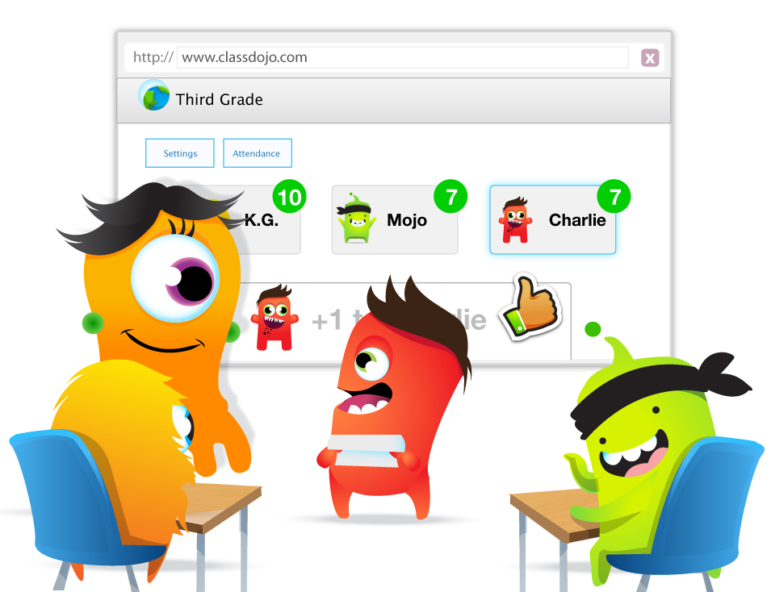
How I use ClassDojo in my classroom
Every day I give feedback to students for skills such as participating, working hard, and being creative!
Students love getting this sort of positive feedback. :)

Slide 13
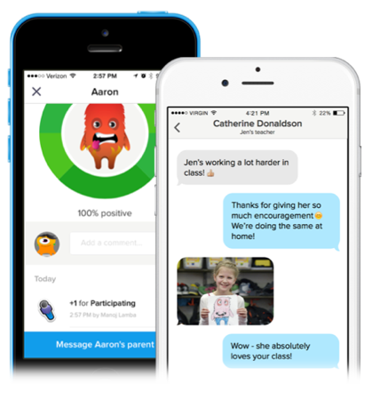
Engaging parents easily!
My relationships with parents are much stronger now - and they also love ClassDojo.
Parents can sign in and see how their child is doing anytime – progress updates are automatic!
I can instantly message with parents, including sharing photos from class.

Slide 14
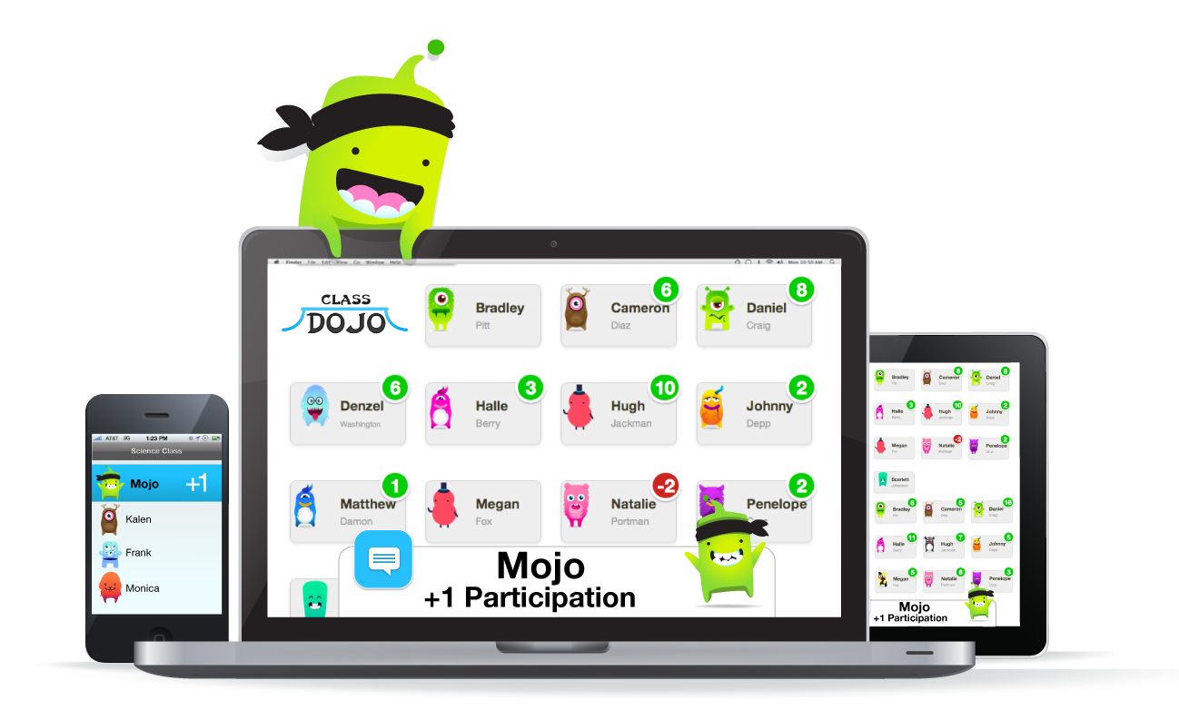
Now, let’s sign up together!
Get out your smartphones, tablets, or laptops!
Download the ClassDojo app on any iOS or Android device!
Or sign up on the web at ClassDojo.com

Slide 15
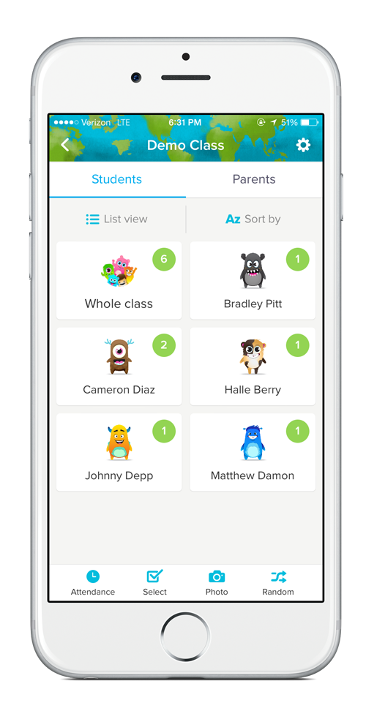
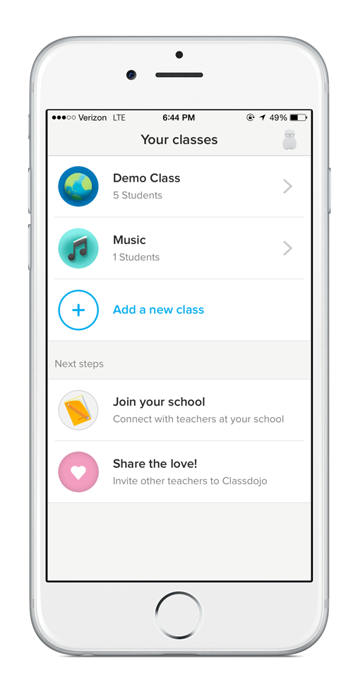
The first few steps are quick
Play around with the Demo Class to see how easy it is to give students feedback.
Create your class and enter your students!
Join your school to see who else is using ClassDojo!

Slide 16
How will you introduce ClassDojo to your students?
Show students their monsters and discuss which skills you’ll be encouraging!
Student Introduction Video

Slide 17
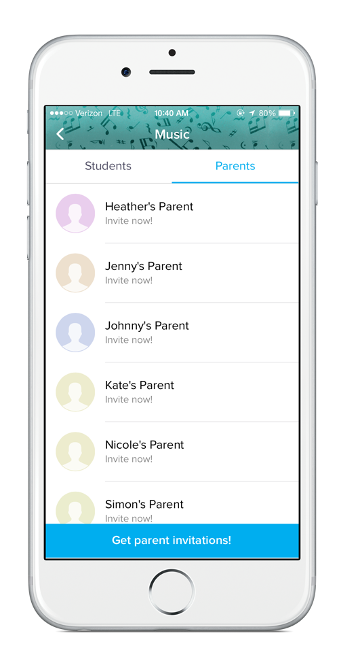
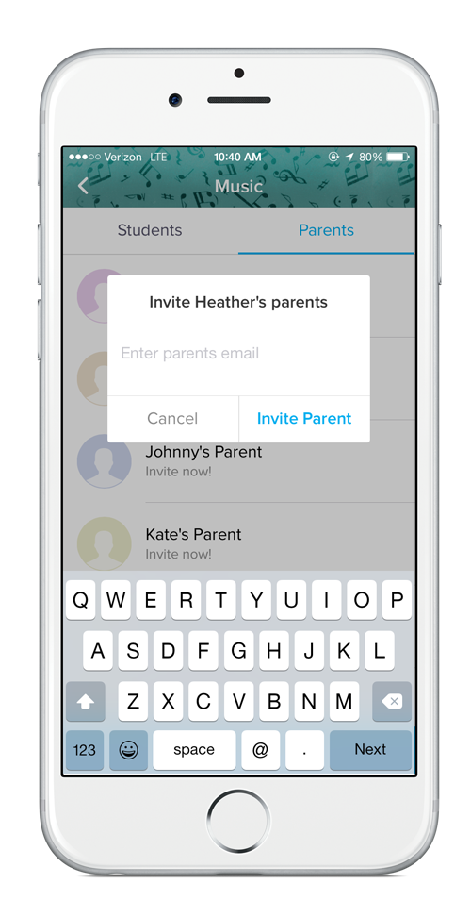
How will you sign up parents?
Having parents on board is extremely helpful for me and my students!
Easily invite parents by clicking on the ‘parents’ tab.
You can either print invites to send home or send an invite directly to their email/cell.

Slide 18
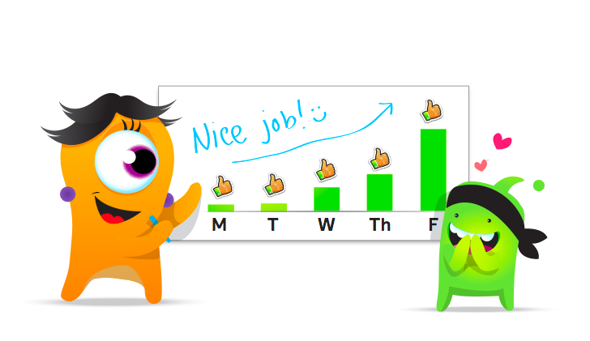
6 top teacher tips
Customize feedback
Encourage the skills and traits most important for your class
Turn up the sound
Let students see and hear the encouragement in class :)
Use the ‘Randomizer’! Mix it up by calling on students with ClassDojo’s ‘Randomizer’!
Share photos
Share classroom moments and students’ work with parents
Set goals
Set weekly goals to encourage your class to grow
Select multiple students
Give points quickly to groups or tables

Slide 19
Helpful resources that will make your life easier :)
Visit ClassDojo.com/Resources for wonderful free resources:
Classroom decorations!
Back-to-school night presentation and video
Introduction letter for parents
Overview and FAQ for admin

Slide 20
Curricular Links
Math and ELA resources and assessments are available VIA Edmodo.com.
Primary Source resources for English or Social Studies can be found at gilderlehrman.org (History by Era for lesson plans)
Readworks.org – Informational, Historical, and Literary close read lessons (great for sub plans)
Promethean Planet
Prezi (public search)
Discovery Education
Check out teacherspayteachers.com search by subject and grade level then browse through the FREE section for some great resources.
Khan Academy – provides online modules students can complete in many subject areas (ELA, Math, History, and more…)
New Orleans Historic Collection – Close reading primary sources (free)
PBS Teacher Center
National Parks Service

Slide 21
Weebly.com
Create a class website or have students create websites as a project based learning activity.
Weebly.com has amazing templates available to create your site and is FREE for educators to use.
Sign up for an account here.

Slide 22
Google Drive
Google Drive is completely free – cloud based storage where you can virtually store all your content to ensure it is always updated on all your devices.
The Google Drive software can be installed on your computer to allow you to save, edit, present directly off the drive folder – saving hard disk space.
Check out these 100 ways you can use Google Drive in the classroom.

Slide 23
Prezi
This is an engaging presentation format that can be used to activate students when delivering content that might be less exciting to students.
Easy video tutorials are available and templates are varied in style and function.
Tutorial on creating and using Prezi presentations.

Slide 24
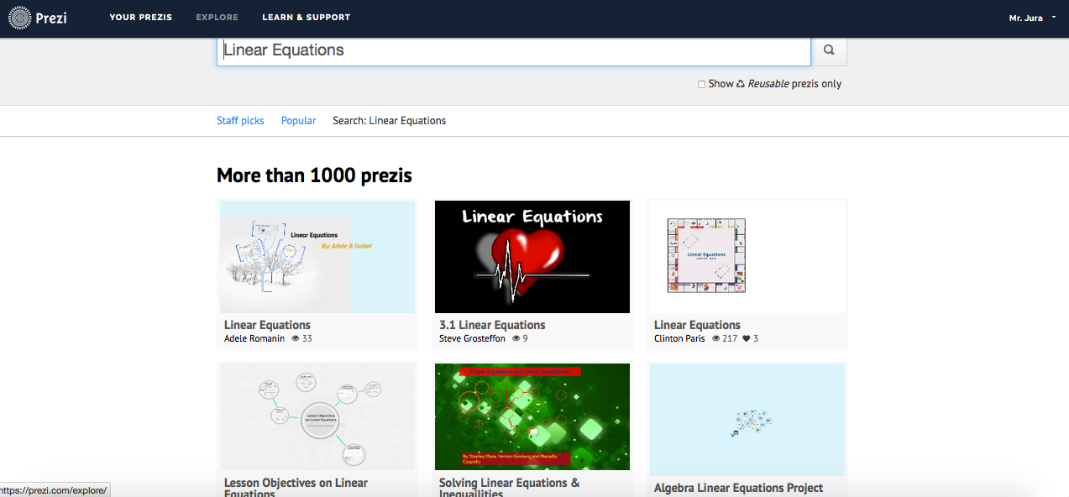

Slide 25
Donorschoose.org
Get the funding you need for your classroom.
Post projects on donorschoose.org for funding and have students share the link on social media.
Students can write the “essay” as a persuasive prompt in class – engagement will be higher if the students are involved in the resource.

Slide 26
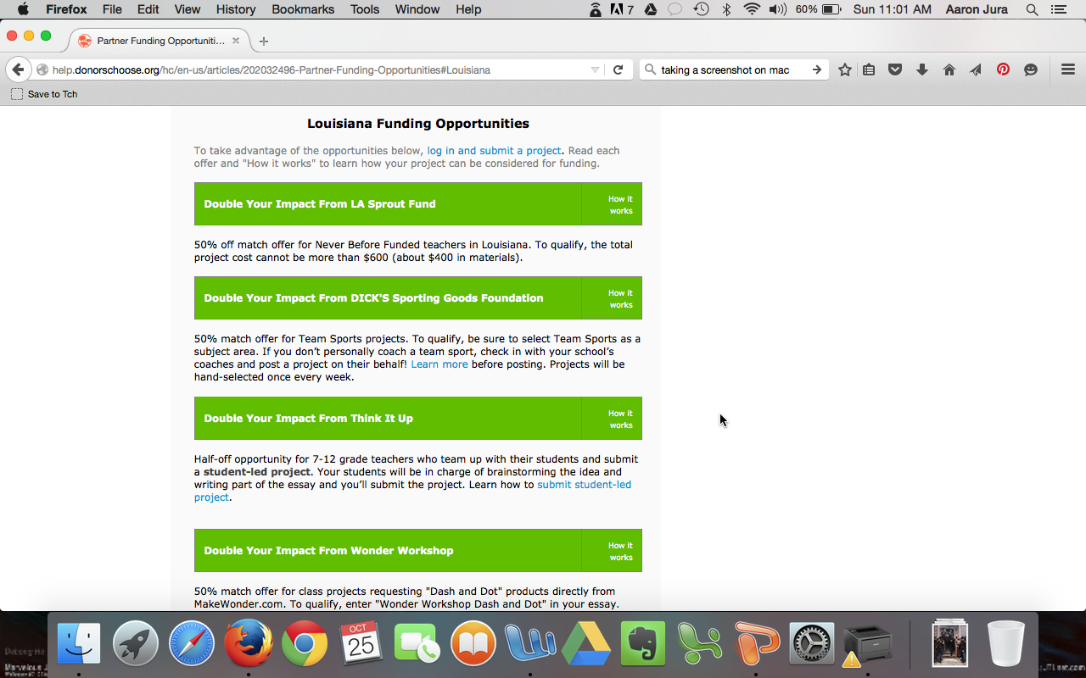

Slide 27
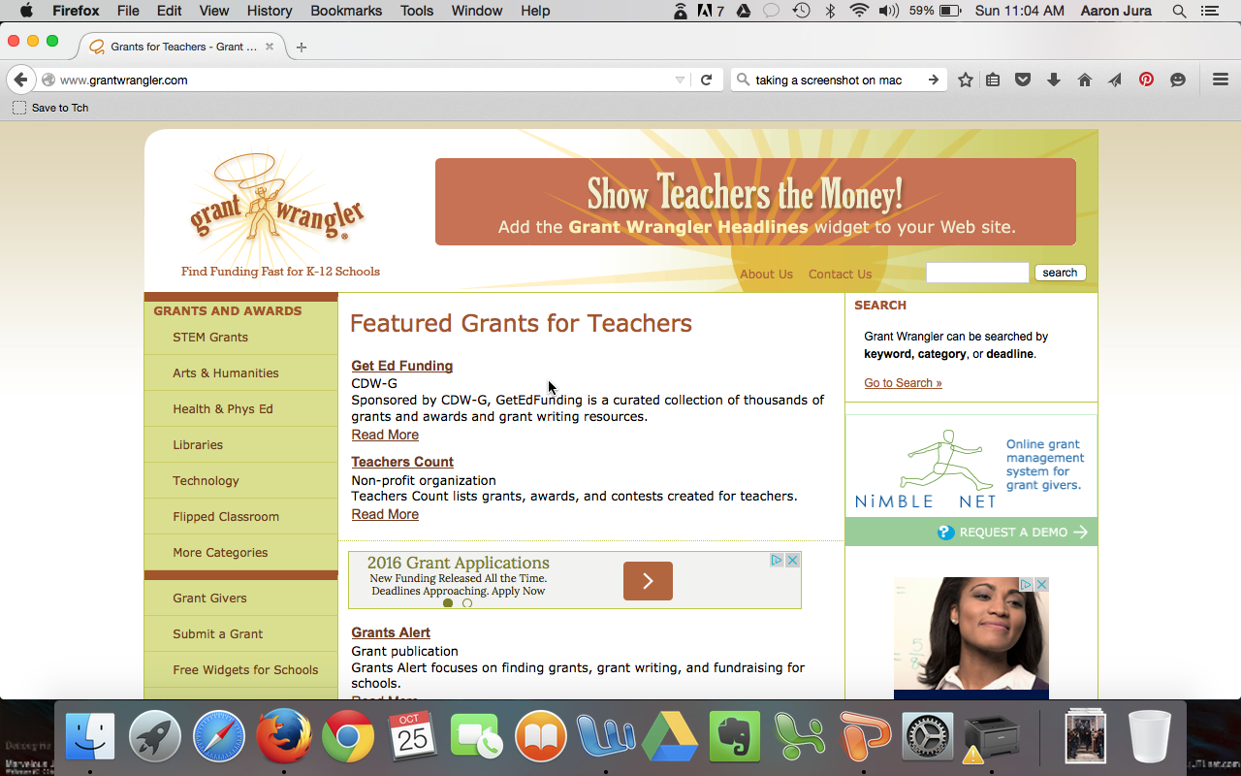

Slide 28
Thanks!
The presentation has been emailed out as a PowerPoint presentation so you will have access to the links.

